Slide 1
Machine Learning Project
UR3 CobotOps
Member : taekmyung kim , Hyunsung Yoo, Dohyun Namgoong

Slide 2
Table of
Contents
01
Introduction to Dataset
02
Problem Definition
03
Preprocessing & Machine Leaning
04
Result

Slide 3
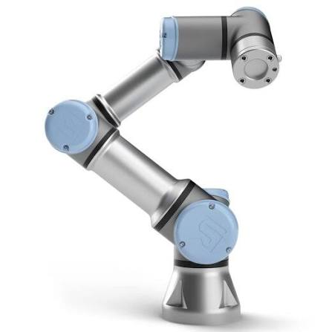
1. Introduction to Dataset
Why We Chose This Dataset

Slide 4
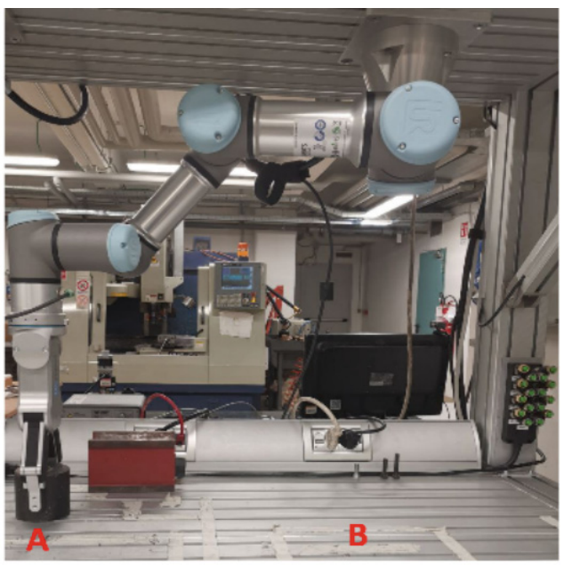
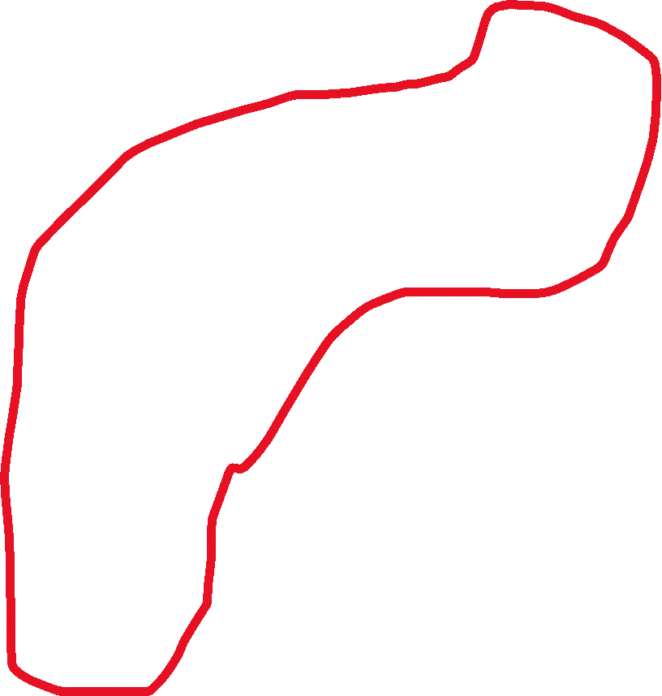
1. Introduction to Dataset

Slide 5
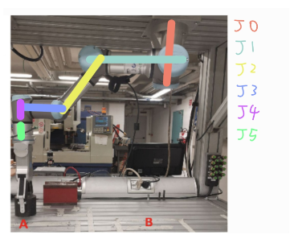
1. Introduction to Dataset

Slide 6
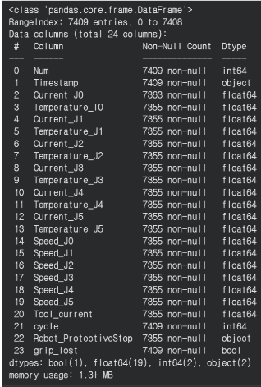
1. Introduction to Dataset
Dataset review
7409 X 24
Current_J0~J5
Temperature_J0~J5
Speed_J0~J5
Tool_current
Robot_ProtectiveStop
grip_lost

Slide 7
2. Problem Definition
Purpose
01
Regression
Tool Current Prediction
02
Classification
System Failure Prediction
03
Clustering
Payload State Discovery

Slide 8
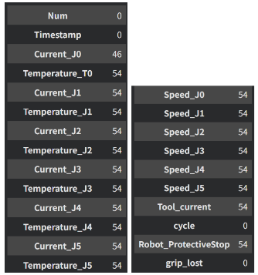
3. Preprocessing
df.isNull().sum()
-> Dropa

Slide 9
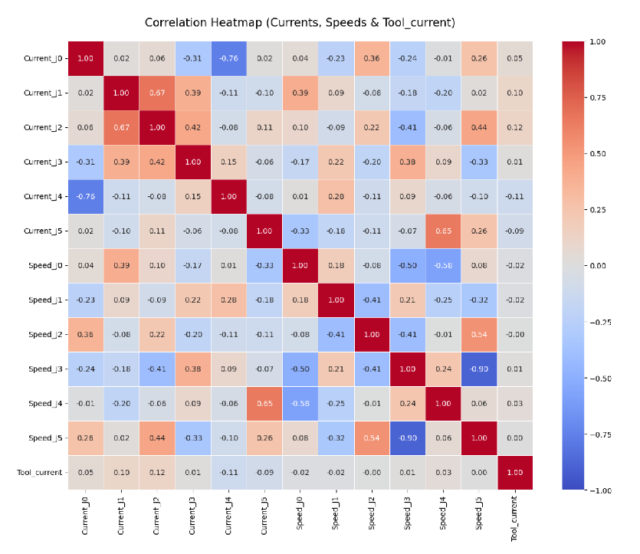
3. Regression – Tool Current Prediction
EDA

Slide 10
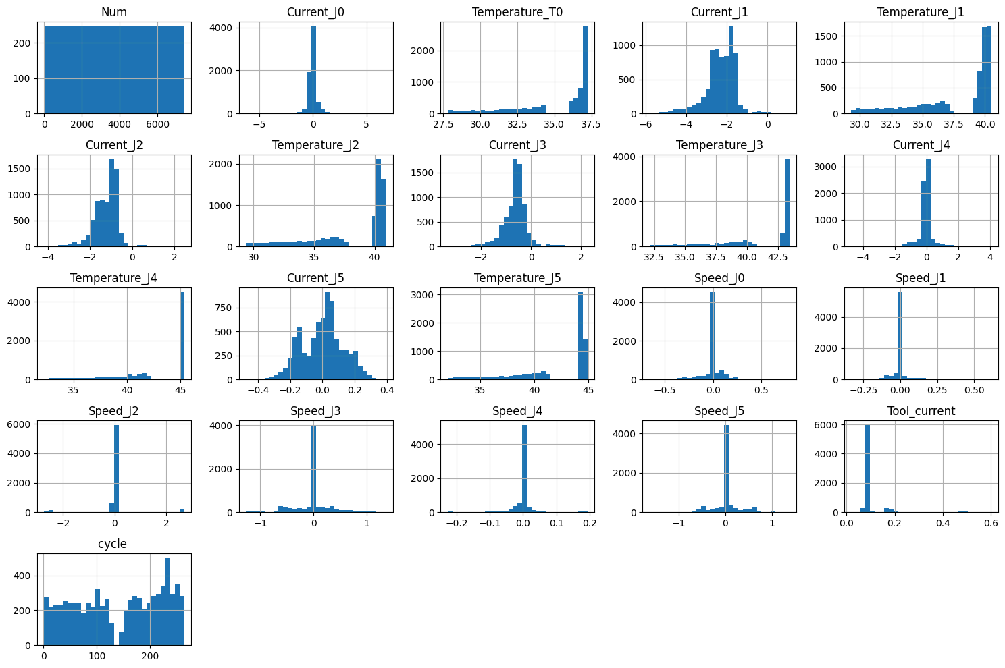
3. Regression – Tool Current Prediction
EDA

Slide 11
3. Regression – Tool Current Prediction
실험 결과
 | Train R2 | Test R2
Linear Regression |  | 0.1047
Polynomial | 0.2786 | 0.2340
Ridge | 0.2499 | 0.2298
Lasso | 0.2492 | 0.2322
ElasticNet | 0.2495 | 0.2334
Decision Tree | 0.6397 | 0.4697
Random Forest | 0.8211 | 0.5848
KNN(K=8) | 1.0000 | 0.5219
Linear Regression,
Decision Tree,
Random Forest,
KNN,

Slide 12
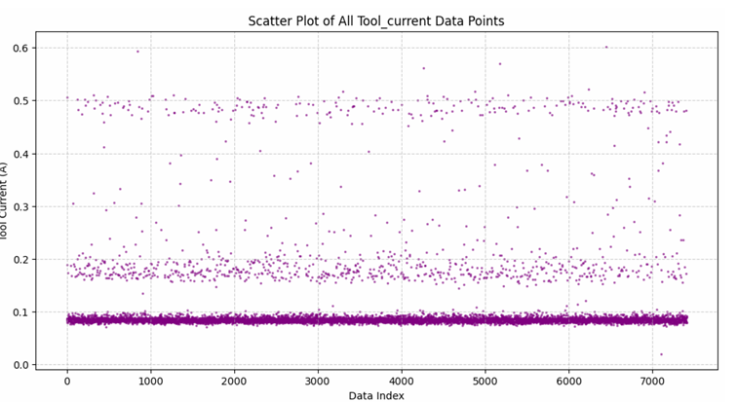
3. Regression – Tool Current Prediction
Result
Although high predictive performance was difficult to achieve in this regression task, the model was able to explain approximately 58% of the variance in Tool Current using only speed-related features.
This suggests that the model learned patterns linking specific robot arm motions and operating speeds to corresponding gripper activities.

Slide 13
3. Regression – Tool Current Prediction
Result
The scatter plot below illustrates the overall distribution of Tool Current values.
Since regression models attempt to minimize prediction error by estimating intermediate values, prediction inaccuracies occur because the actual Tool Current is concentrated in several discrete operating states rather than continuously distributed.

Slide 14
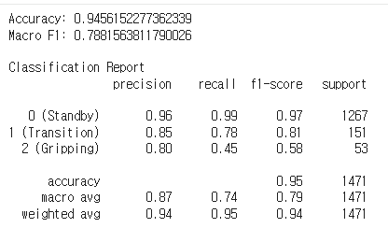
3. Regression – Tool Current Prediction
Result
It was confirmed that there was a clear association between joint data and tool current. However, it was concluded that it was much more useful to approach the classification problem of matching the gripper's current operating state rather than the regression of successive numbers.
As a result of learning with the classification models Logistic Regression and Random Forest on the same subject, the F1-score recorded 0.2 and 0.57, respectively

Slide 15
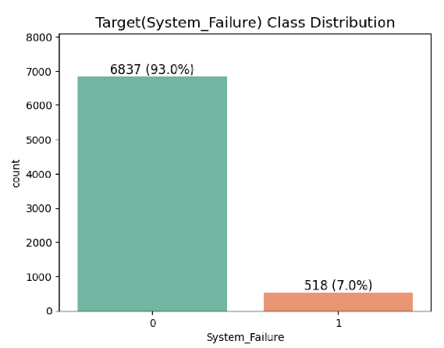
3. Classification – System Failure Prediction
EDA
Make System Failure Label
System Failure = Protective Stop = 1 or grip lost = 1
Normal 93%, Abnormal 7%
Need SMOTE

Slide 16
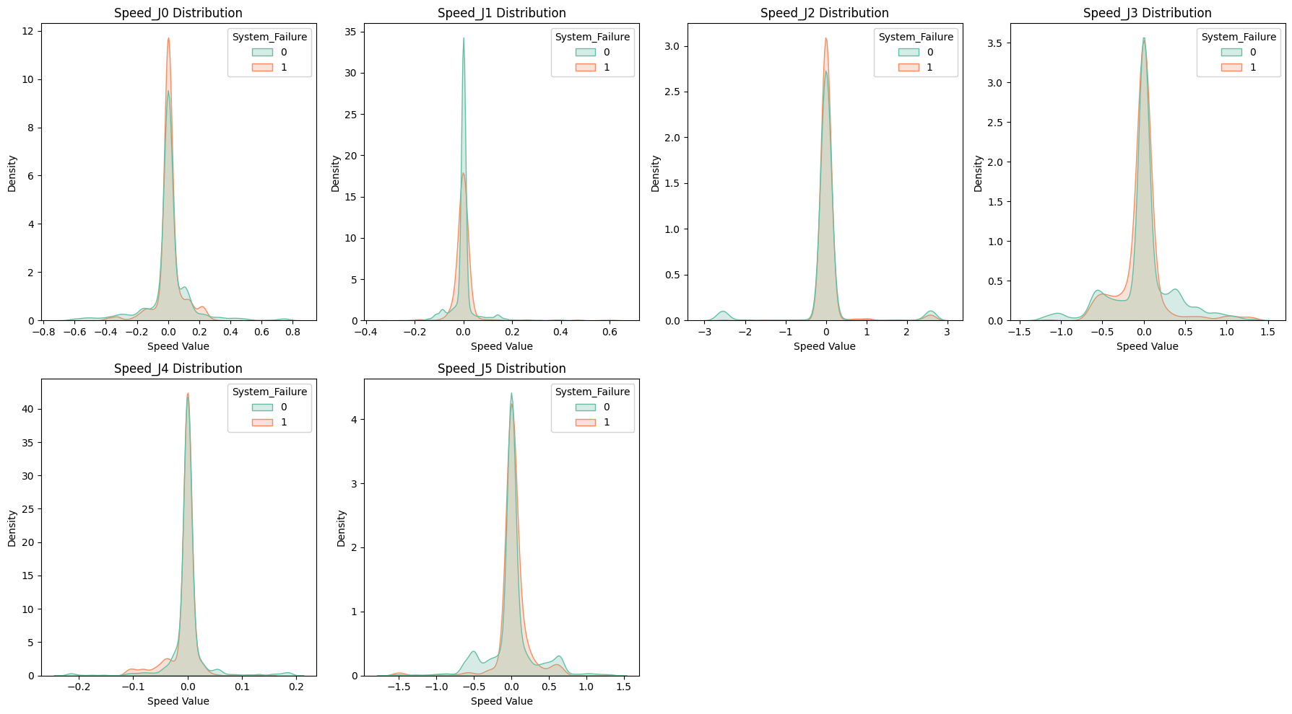
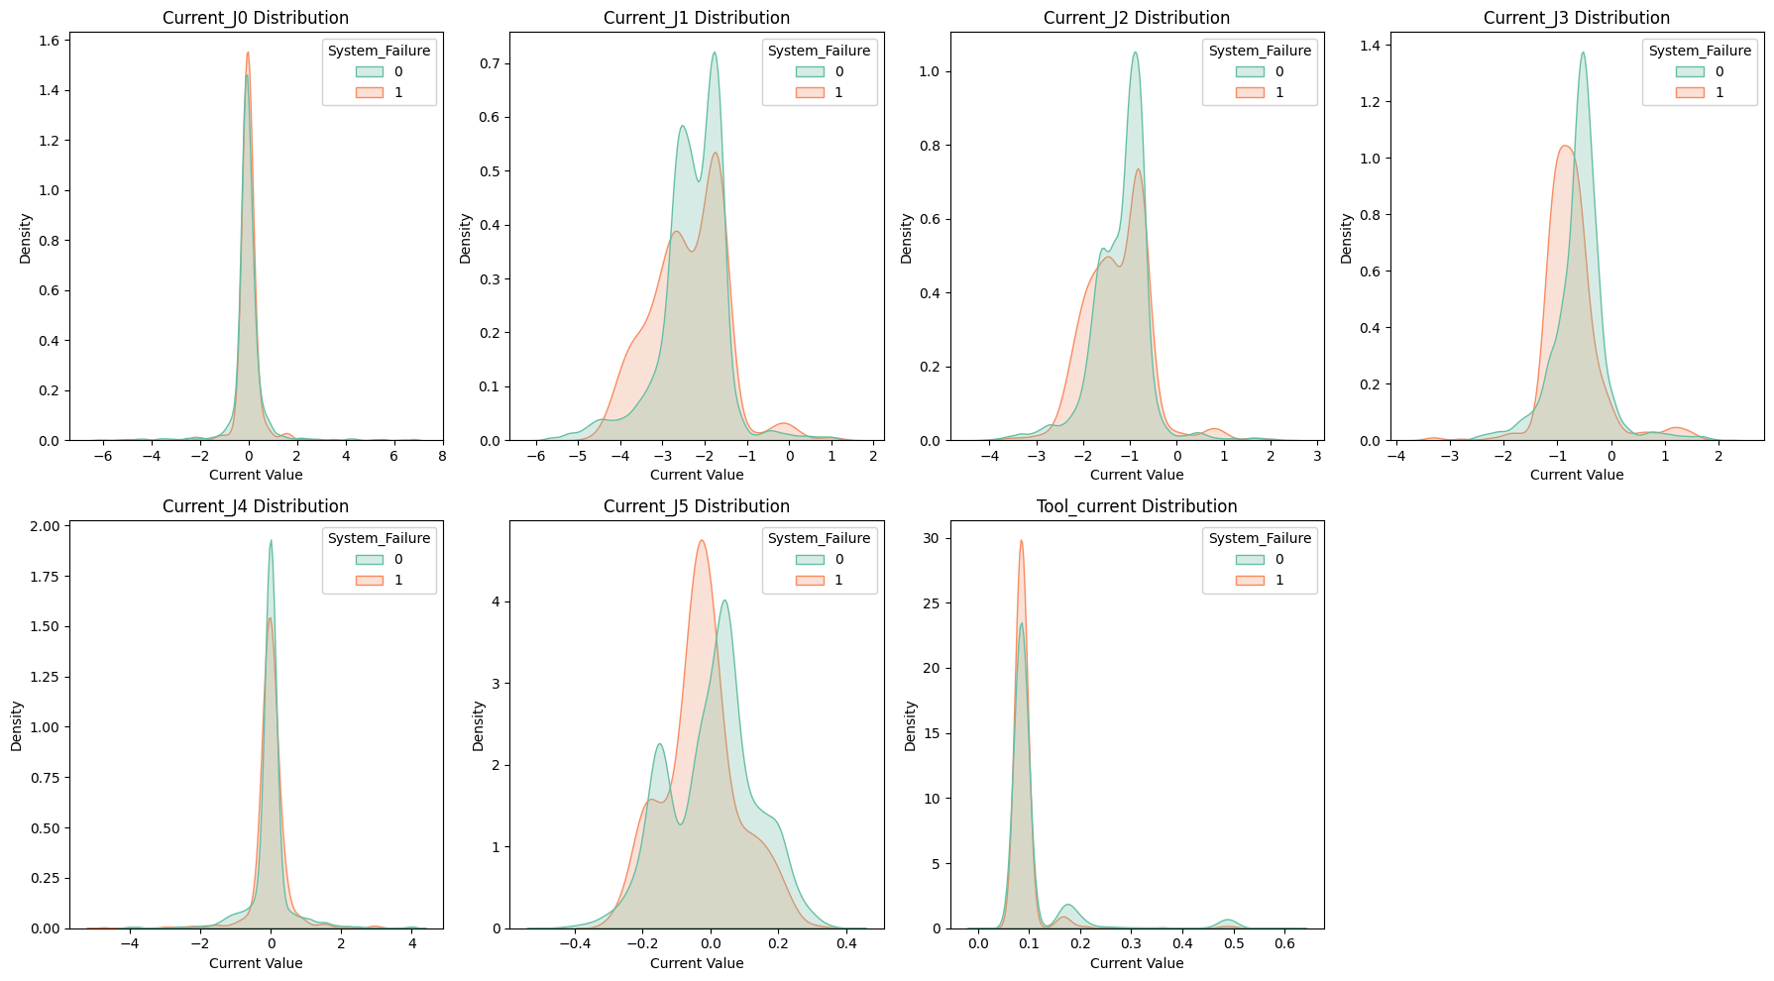
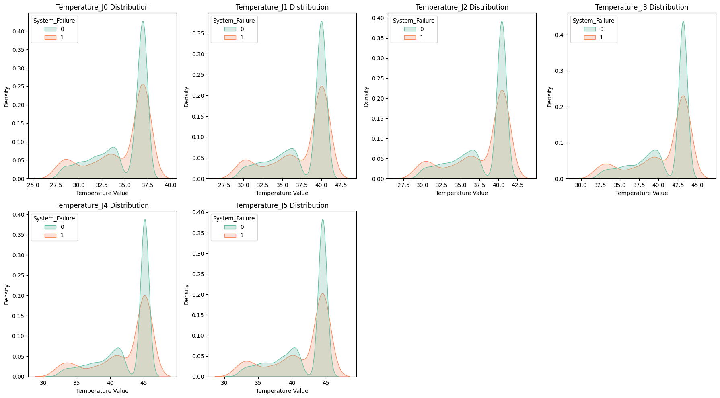
3. Classification – System Failure Prediction
EDA

Slide 17
3. Classification – System Failure Prediction
실험 결과
 | F1-score | Recall | Precision
Logistic Regression | 0.24 | 0.75 | 0.14
SVM | 0.51 | 0.75 | 0.39
Decision Tree | 0.47 | 0.62 | 0.38
Random Forest | 0.63 | 0.65 | 0.61
KNN | 0.50 | 0.66 | 0.40

Slide 18
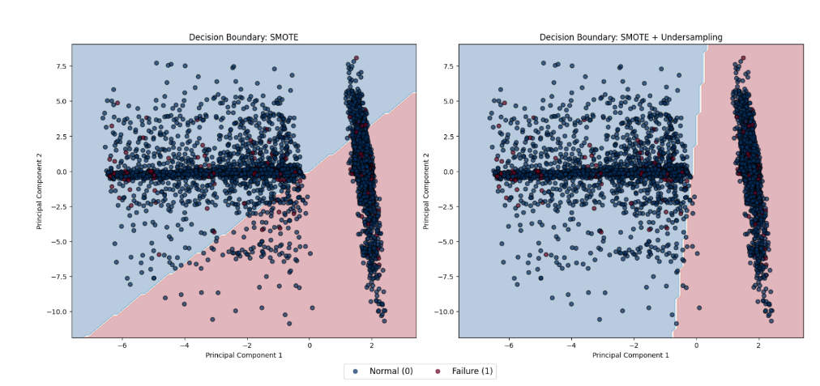
3. Classification – System Failure Prediction
Result – Logistic Regression
Blue dot: normal, red dot: failure
Left: SMOTE, right: SMOTE + undersampling
Failure samples are deeply mixed with normal samples in both cases
The dataset exhibits a non-linearly separable structure
Linear classification is therefore inherently limited

Slide 19
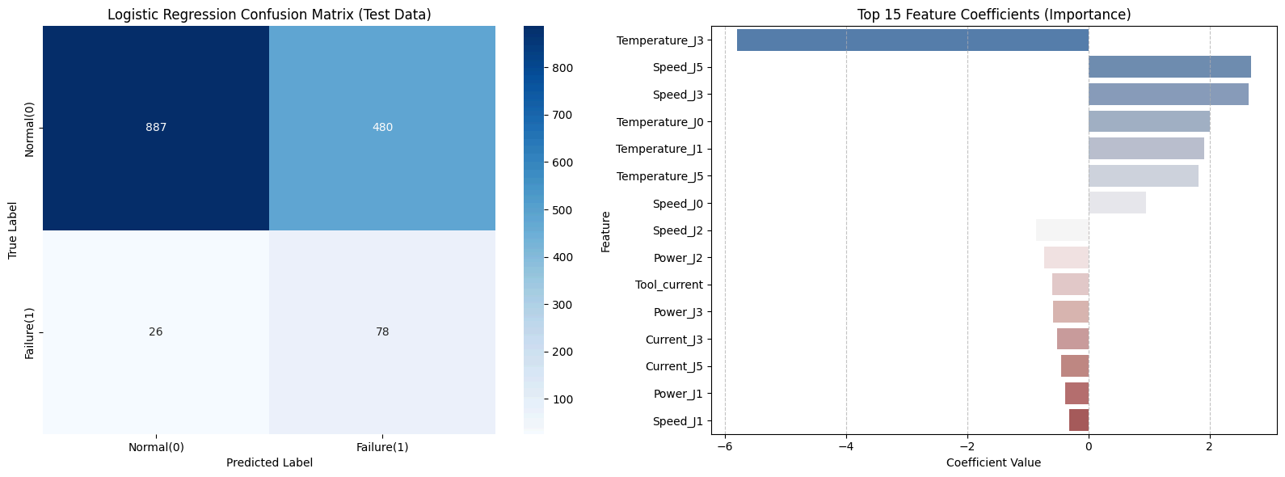
3. Classification – System Failure Prediction
Result – Logistic Regression
TN : 887 FP : 480 FN : 26 TP : 78

Slide 20
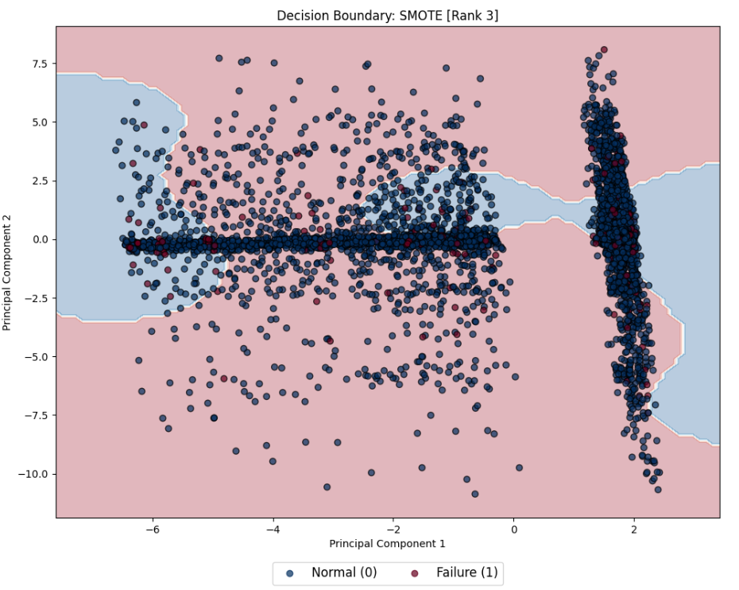
3. Classification – System Failure Prediction
Result – SVM

Slide 21
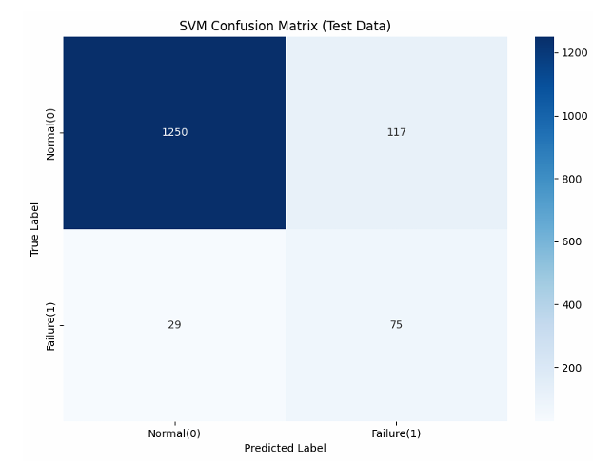
3. Classification – System Failure Prediction
실험 결과 – SVM
TN : 1250 FP : 117 FN : 29 TP : 75

Slide 22
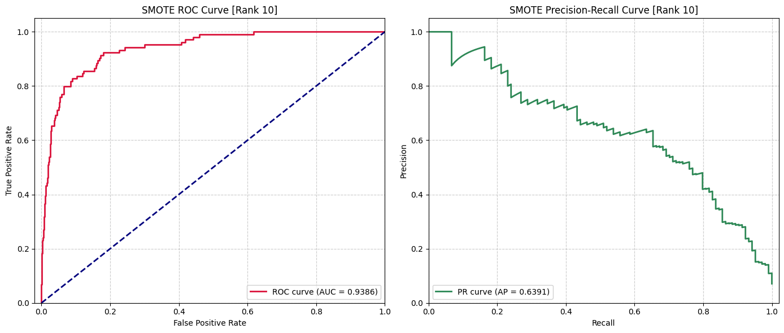
3. Classification – System Failure Prediction
Result – Random Forest
ROC Curve, PR Curve
ROC-AUC 0.938

Slide 23
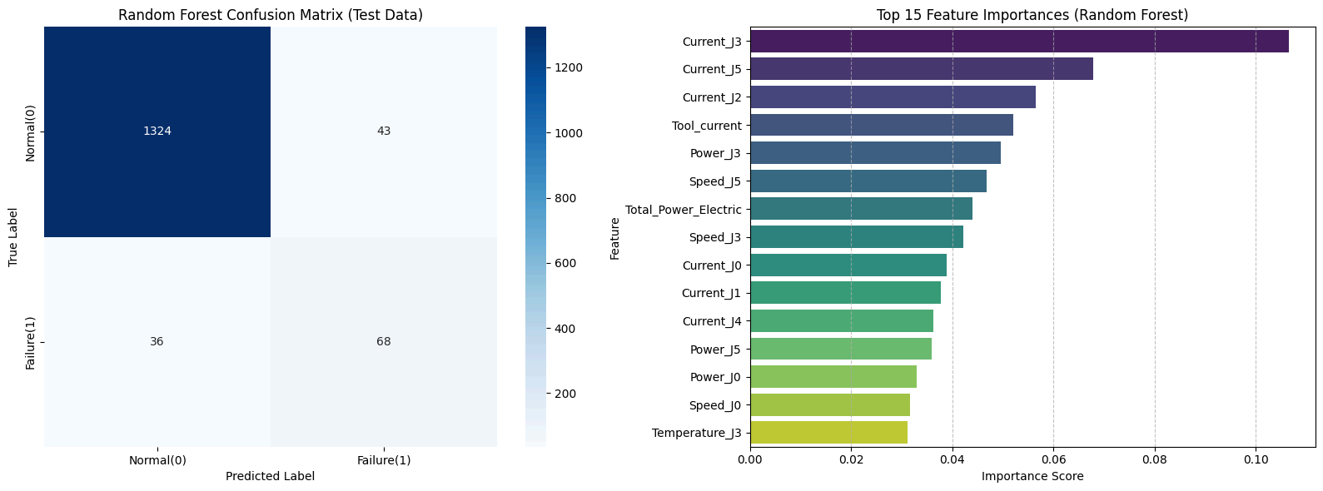
3. Classification – System Failure Prediction
Result – Random Forest
TN : 1324 FP : 43 FN : 36 TP : 68

Slide 24
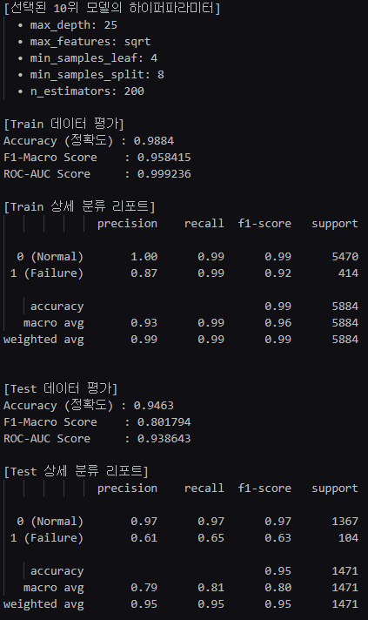
3. Classification – System Failure Prediction
Result – Random Forest
TN : 1324 FP : 43 FN : 36 TP : 68

Slide 25
3. Classification – System Failure Prediction
Result
The dataset exhibited severe class imbalance, with approximately 93% normal samples and 7% failure samples, making Accuracy alone insufficient for reliable evaluation.
To address this issue, SMOTE was applied to the training data, and model performance was evaluated using F1-score, Recall, Precision, and ROC-AUC.
Analysis of the Logistic Regression decision boundary revealed that failure samples were heavily embedded within normal samples, indicating that the data is not linearly separable.
Therefore, the relationship between the input features and system failures is likely to involve complex non-linear patterns rather than simple linear relationships.
Non-linear models such as Random Forest consistently outperformed linear models, with Random Forest demonstrating the most stable generalization performance.

Slide 26
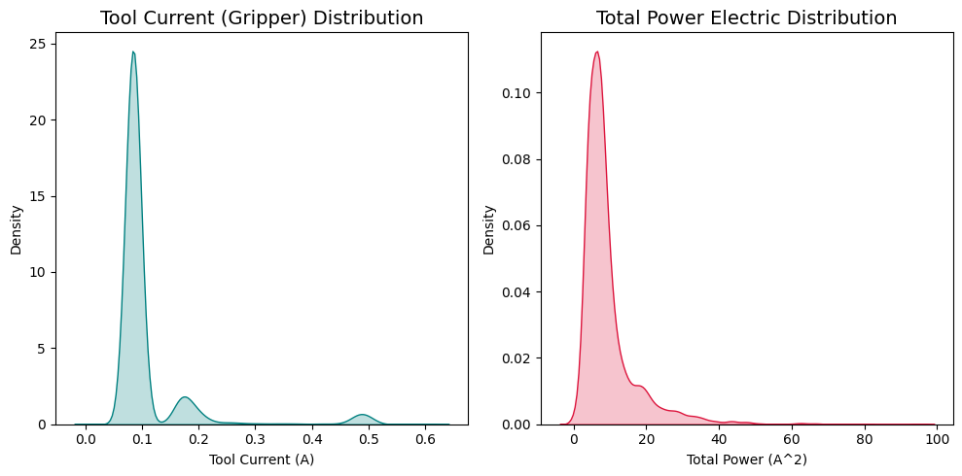
4. Clustering – Payload State Discovery
EDA
Tool Current showed three distinct peaks around 0.08A, 0.18A, and 0.49A.
This suggests the existence of multiple operating states.

Slide 27
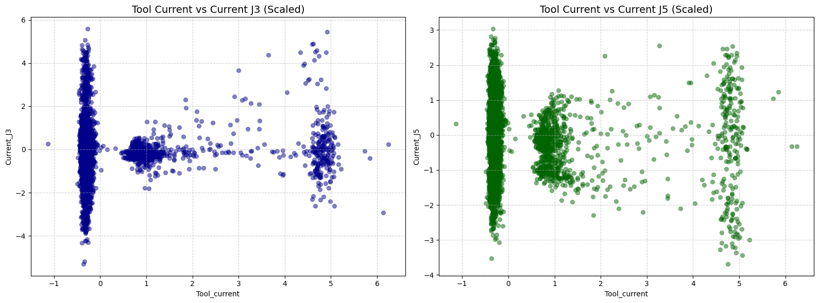
4. Clustering – Payload State Discovery
EDA

Slide 28
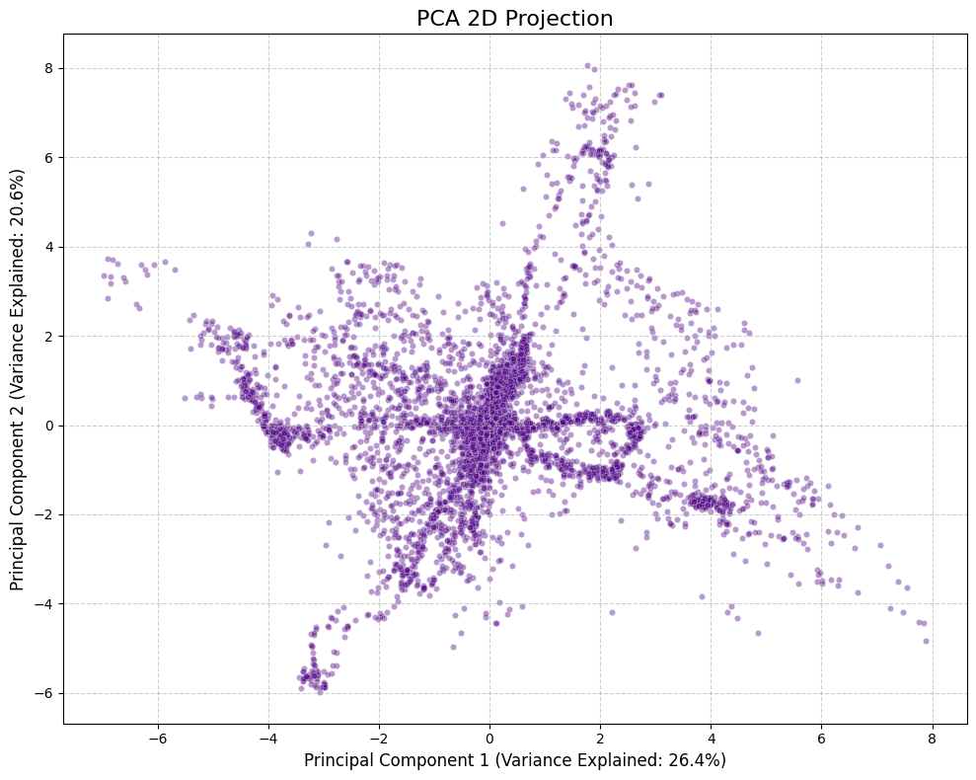
4. Clustering – Payload State Discovery
EDA
PCA was used to visualize the overall structure of the data.
Multiple branches and dense regions were observed, indicating potential cluster structures.

Slide 29
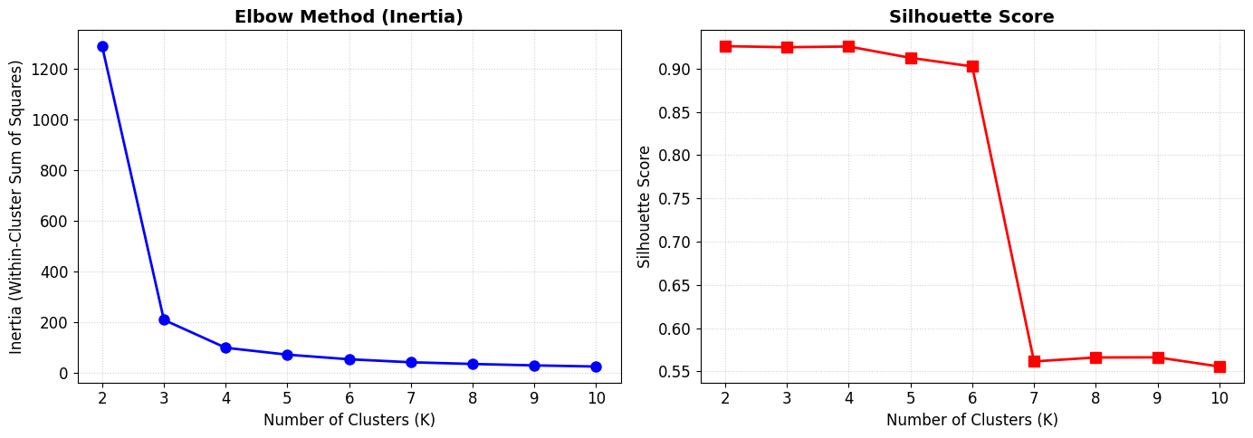
4. Clustering – Payload State Discovery
Result – k-means
Since Tool Current showed three major peaks, K=3 was selected as the primary candidate.

Slide 30
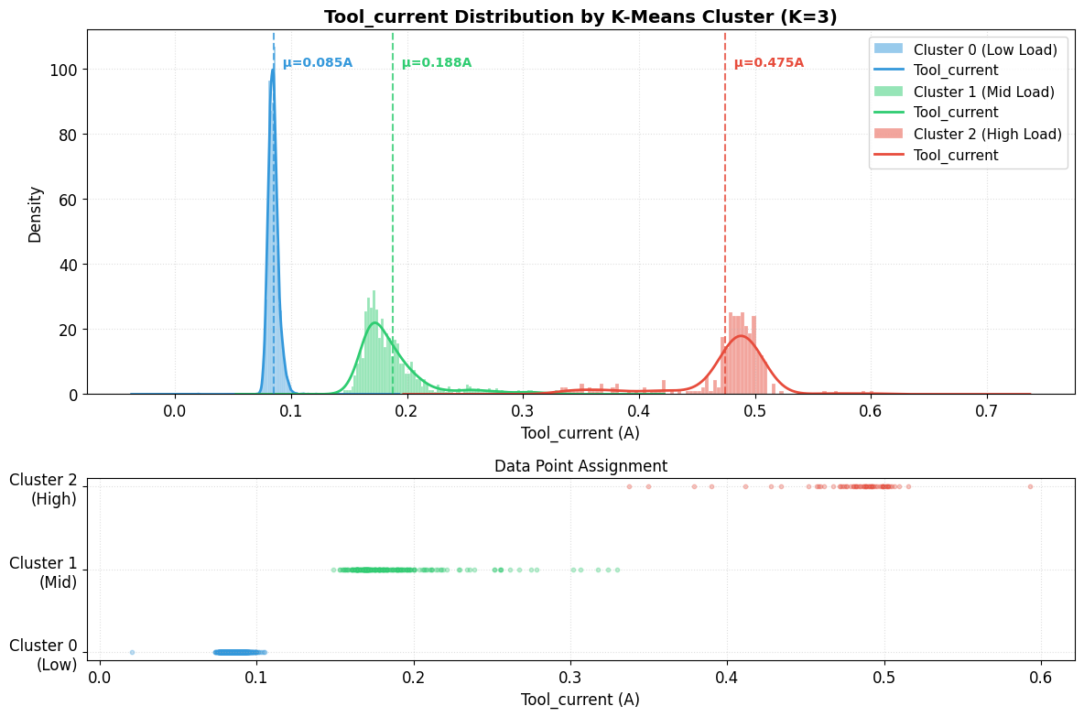
4. Clustering – Payload State Discovery
Result - k-means

Slide 31
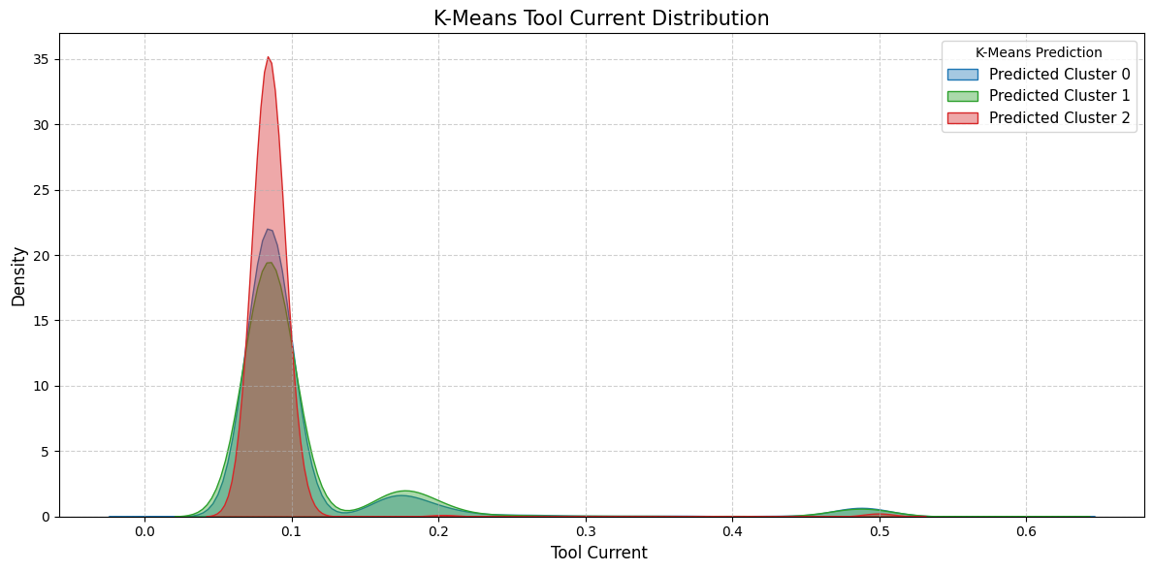
4. Clustering – Payload State Discovery
Result

Slide 32
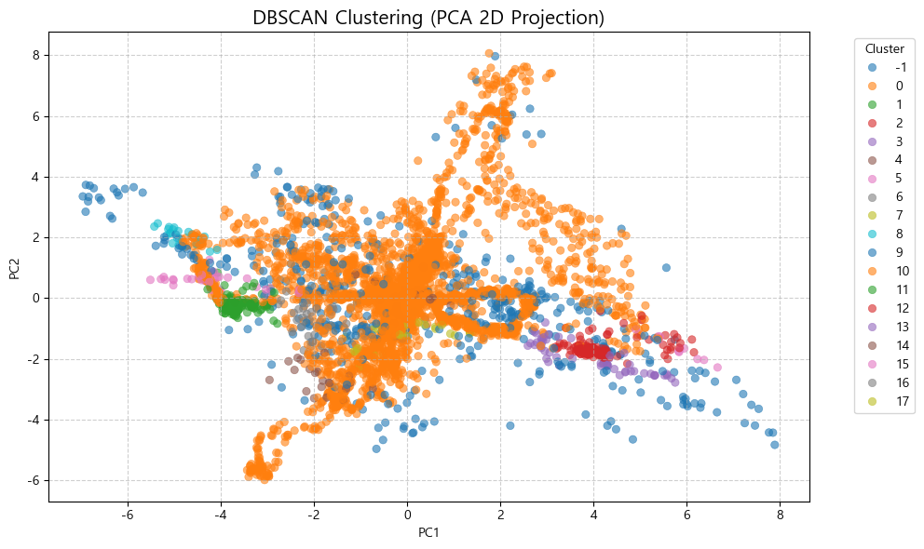
4. Clustering – Payload State Discovery
Result - DBSCAN

Slide 33
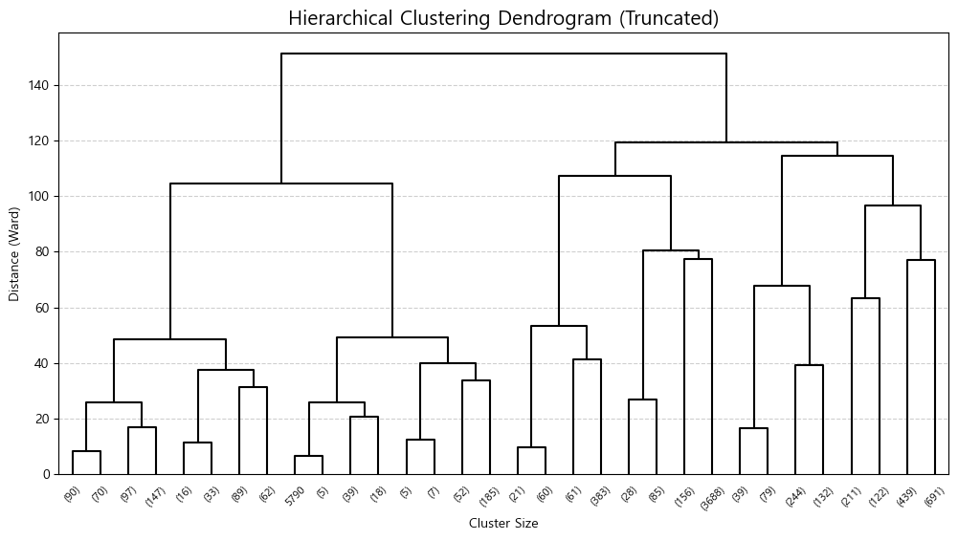
4. Clustering – Payload State Discovery
Result - Hierarchical Clustering

Slide 34
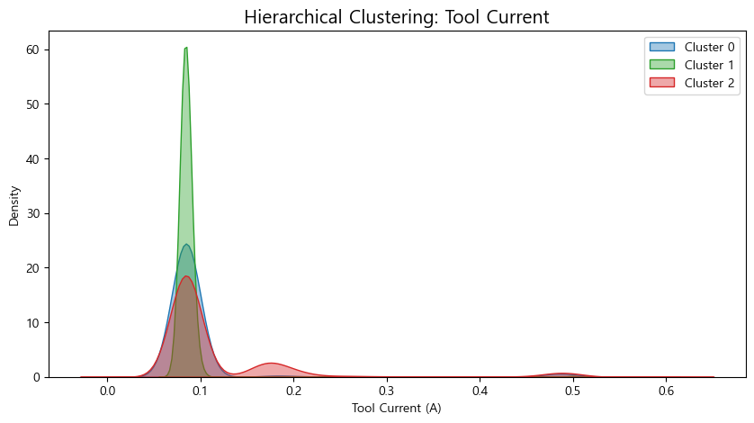
4. Clustering – Payload State Discovery
Result - Hierarchical Clustering

Slide 35
4. Clustering – Payload State Discovery
Result
Tool Current exhibited three distinct operating regions.
K-Means successfully recovered these regions with the highest cluster quality.
DBSCAN generated many small local clusters and did not align well with payload states.
Hierarchical clustering captured some structure but produced less distinct separation.
Therefore, K-Means was selected as the most appropriate clustering method for payload state discovery.

